Slide 1
HERCULES 2021 - TUTORIAL Modelling SR beamlines using OASYS
Manuel Sánchez del Río
AAMP, MEG, ISDD, ESRF
2021 March 3rd 14:00

Slide 2
Outline
Introduction to OASYS
XOPPY toolbox: Source emission and characteristics of optical elements. Power transport
ShadowOUI: Ray tracing SR beamlines
Mirror aberrations
Crystal systems
Lenses
WOFRY and SRW: coherent beam transport:
Simple examples with WOFRY
Introduction to Partial coherence

Slide 3
Outcome Calculate main characteristics of synchrotron sources (dipoles and IDs) Simulating beamline optics by ray-tracing to obtain main parameters of beam size, energy resolution and flux Understand basic principles of x-ray optics: Reflective (aberrations, slope errors), Diffractive (dispersion) and Refractive (chromatic aberrations) A few concepts about coherence

Slide 4
Outline
Introduction to OASYS
XOPPY toolbox: Source emission and characteristics of optical elements. Power transport
ShadowOUI: Ray tracing SR beamlines
Mirror aberrations
Crystal systems
Lenses
WOFRY and SRW: coherent beam transport:
Simple examples with WOFRY
Introduction to Partial coherence

Slide 5

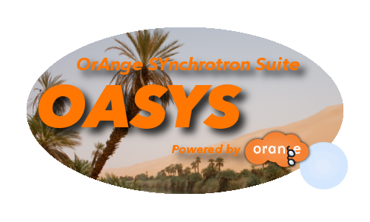
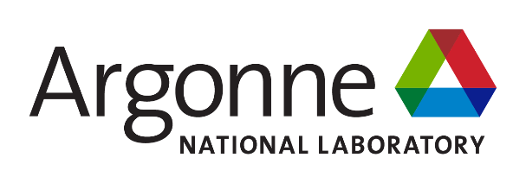
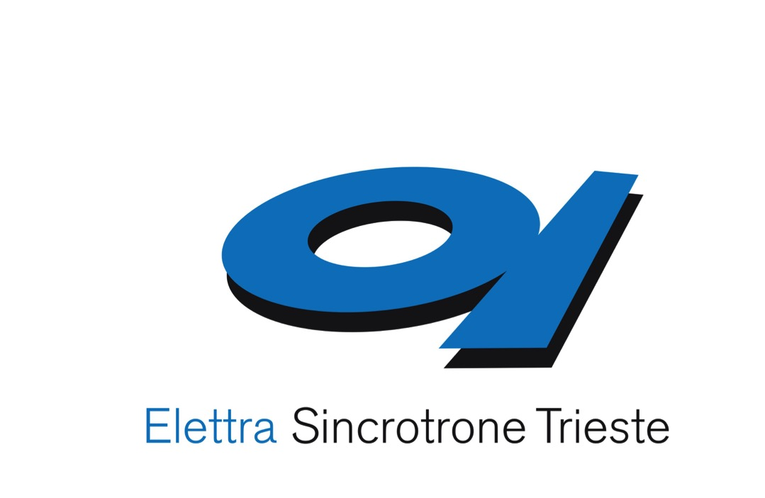

The OASYS Project
https://oasys-kit.github.io/
Luca Rebuffi
Manuel Sanchez del Rio
OASYS = OrAnge SYnchrotron Suite
A common platform to build synchrotron-oriented User Interfaces that communicate
The upper layer of the application presented to the user
Open Source & Python technology
Luca Rebuffi, Manuel Sanchez del Rio (2017)
OASYS (OrAnge SYnchrotron Suite) : an open-source graphical environment for x-ray virtual experiments
Proc.SPIE 10388: 10388-10388. http://dx.doi.org/10.1117/12.2274263
Notes:
Slide 3 – (..) : Content of the presentation
Insert a new slide: Home > “New Slide” and choose a slide Layout:
For Title & Subtitle
For text with bullet points
For Text
For Picture, graphs, visuals
Two columns
Blank
If you want Copy & paste an element from the Clip Board to the particular slide: 1. Click on a box to mark it.
2. Position the mouse pointer on the box frame: Copy! 3. Click on the particular slide: Paste!
How you intend to use the elements is your choice. You can combine the text block style with the background colour in different manner.

Slide 6
Synchrotron Virtual Experiments
Beamline Experiment Chain
Storage Ring
(e⁻ optics)
Radiation devices
(e⁻ -> γ)
Beamline
(γ optics)
Sample
(γ −matter interactions)
Upper layer based
on ORANGE (U Ljubljana)
Suite of Add-ons
XOPPY
ShadowOui
WOFRY
SRW
X-ray server
WISE
COMSYL

Slide 7
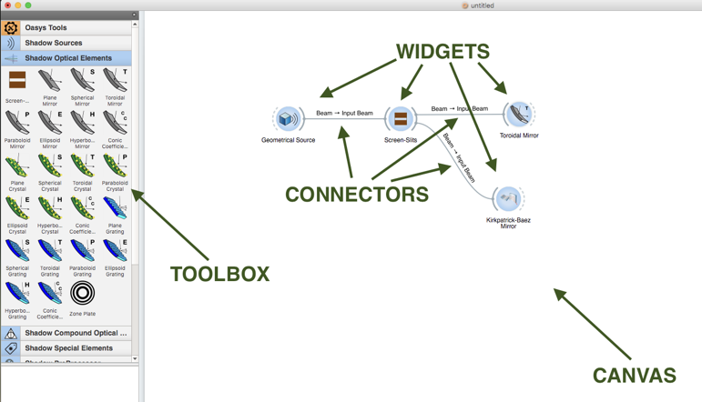
The OASYS language

Slide 8
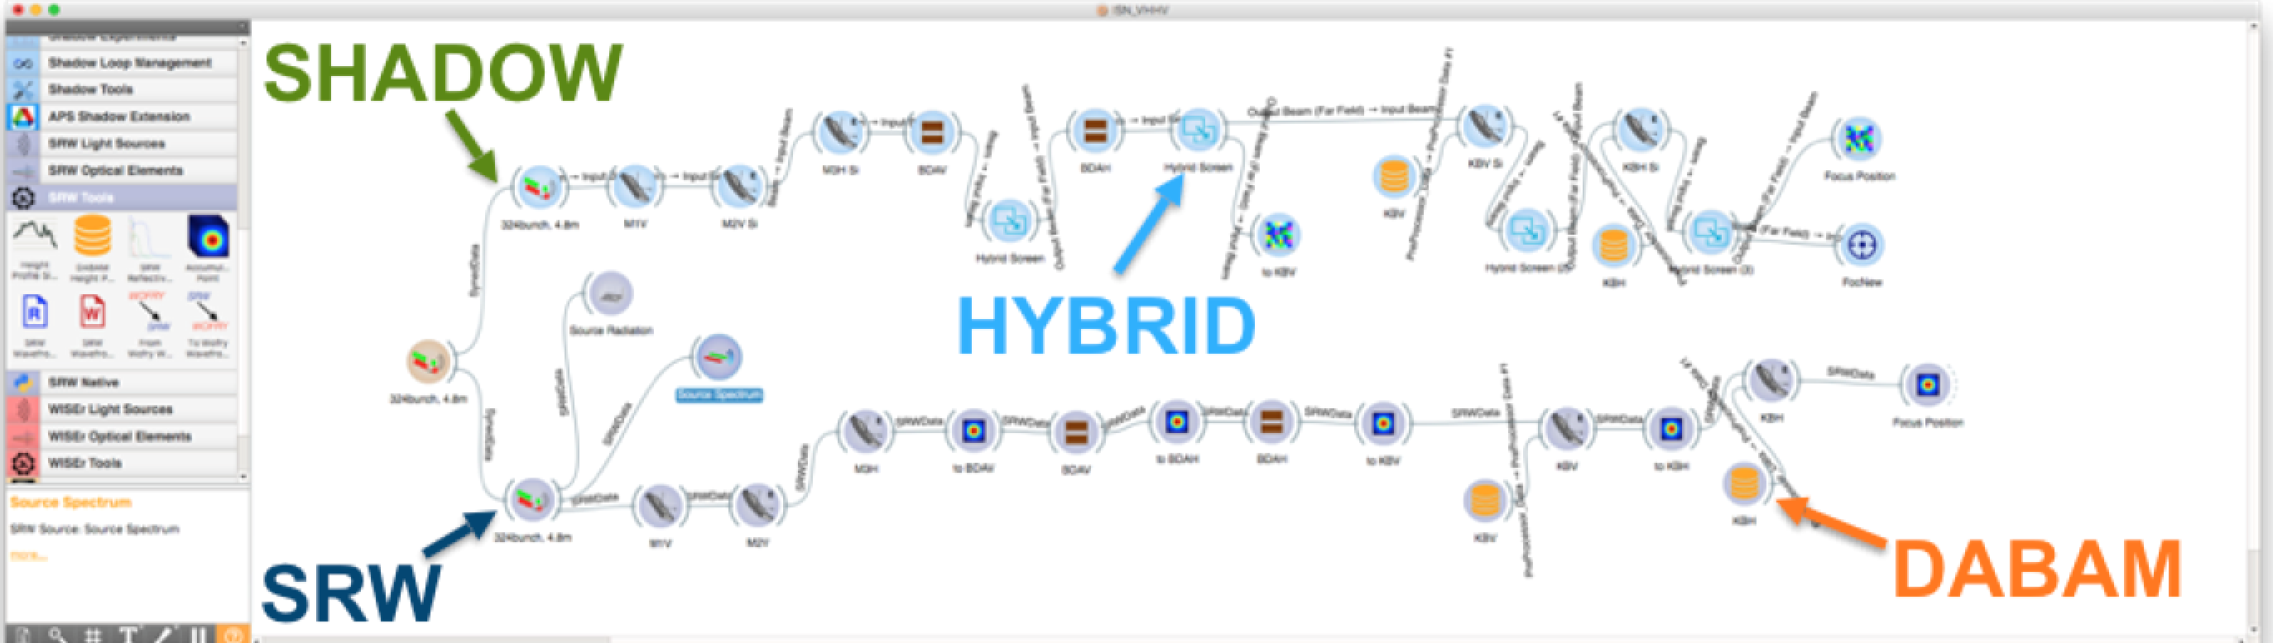
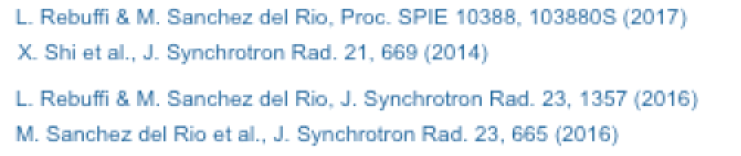
Multiple tools in the same environment

Slide 9
References
Official Web Page
https://www.aps.anl.gov/Science/Scientific-Software/OASYS
or https://oasys-kit.github.io/
M. Sanchez del Rio, L. Rebuffi, J. Demšar, N.Canestrari and O. Chubar, A proposal for an open source graphical environment for simulating X-ray optics, Proc. SPIE 9209, 92090X (2014)​
X. Shi, R. Reininger, M. Sanchez del Rio, L. Assoufid, A hybrid method for X-ray optics simulation: combining geometric ray-tracing and wavefront propagation, J. Synchrotron Rad. 21, 669 (2014)
X. Shi, R. Reininger, M. Sanchez del Rio, J. Qian, L. Assoufid, X-ray optics simulation and beamline design using a hybrid method: diffraction-limited focusing mirrors, Proc. SPIE, 9209, 920909 (2014)
OASYS Publications
M. Sanchez del Rio, D. Bianchi, D. Cocco, M. Glass, M. Idir, J. Metz, L. Raimondi, L. Rebuffi, R. Reininger, X. Shi, F. Siewert, S. Spielmann-Jaeggi, P. Takacs, M. Tomasset, T. Tonnessen, A. Vivo and V. Yashchuk, DABAM: an open-source database of X-ray mirrors metrology, J. Synchrotron Rad. 23 (2016).
L. Rebuffi, M. Sanchez del Rio, ShadowOui: A new visual environment for X-ray optics and synchrotron beamline simulations, J. Synchrotron Rad. 23 (2016)
L. Rebuffi, M. Sanchez del Rio, Interoperability and complementarity of simulation tools for beamline design in the OASYS environment, Proc. SPIE 10388, 1038808 (2017)​.​​​​​​
L. Rebuffi, M. Sanchez del Rio, OASYS (OrAnge SYnchrotron Suite): an open-source graphical environment for x-ray virtual xperiments, Proc. SPIE 10388, 103880S (2017)​​​​​.

Slide 10
Three sessions
XOPPY (tools) hercules_xoppy.ows
ShadowOUI (ray tracing) hercules_shadowoui.ows
WOFRY (wave optics) hercules_wofry.ows

Slide 11
X-ray optics for synchrotron and XFEL beamlines
Computer simulation of light sources and optical components is a mandatory step in the design and optimization of synchrotron and FEL radiation beamlines
different codes for numerical simulations are available, implementing different physical approaches
RAY-TRACING
WAVEFRONT
PROPAGATION
Shadow
RAY
SRW
PHASE
COMSYL
XRT
McXtrace
WISE
WOFRY
Incorerent X-ray beams Fully coherent X-ray beams
Notes:
Slide 3 – (..) : Content of the presentation
Insert a new slide: Home > “New Slide” and choose a slide Layout:
For Title & Subtitle
For text with bullet points
For Text
For Picture, graphs, visuals
Two columns
Blank
If you want Copy & paste an element from the Clip Board to the particular slide: 1. Click on a box to mark it.
2. Position the mouse pointer on the box frame: Copy! 3. Click on the particular slide: Paste!
How you intend to use the elements is your choice. You can combine the text block style with the background colour in different manner.

Slide 12
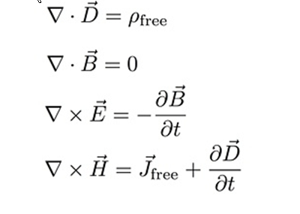
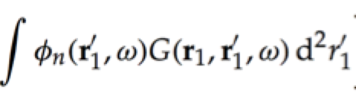
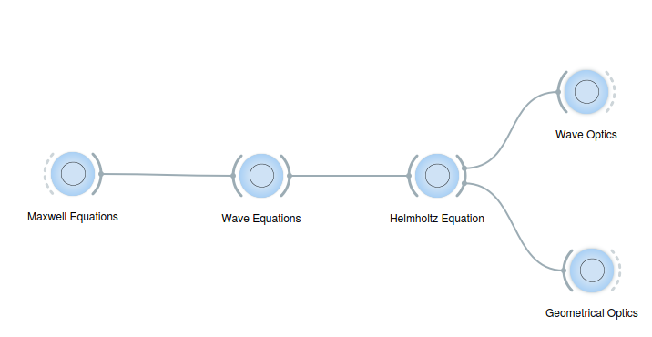
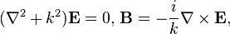
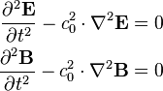
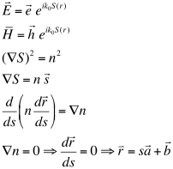
From theory to software
Propagation of one wavefront.
One wavefront is coherent by nature.
A wavefront is approximated by a ray. Many rays are summed up to form a beam, that is incoherent.

Slide 13
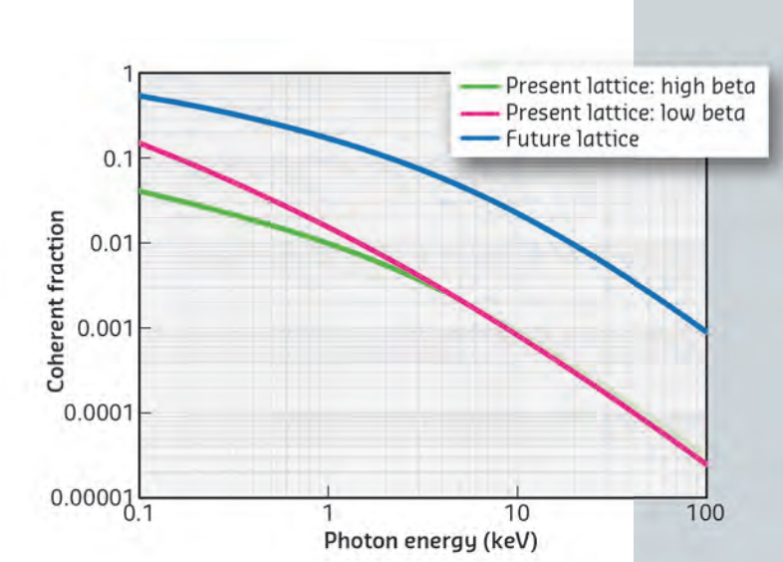
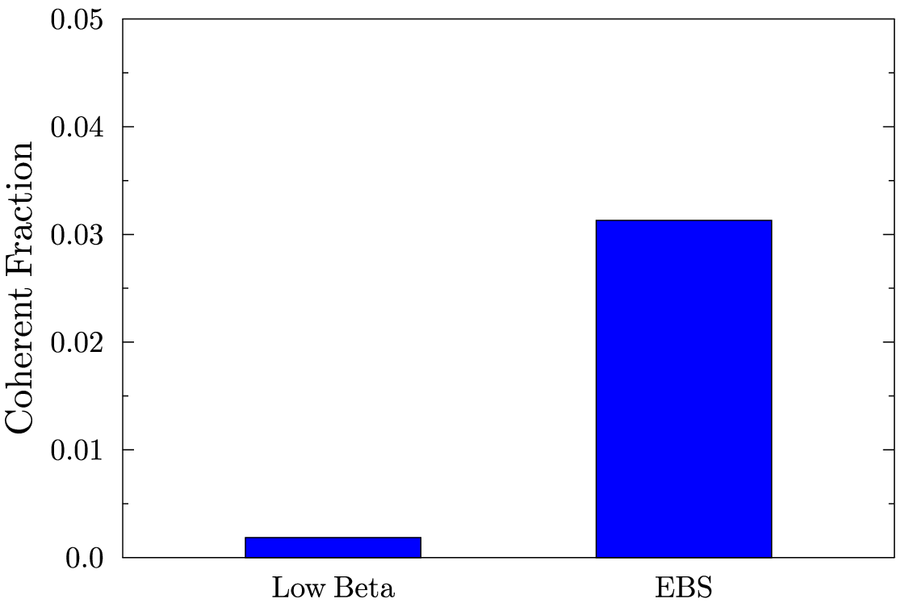
At HIGH ENERGIES, WE ARE FAR FROM DIFFRACTION-LIMIT (=FULLY COHERENCE) THEREFORE, ANY BEAMLINE SIMULATION MUST START WITH RAY TRACING (INCOHERENT BEAMS)
3.13 %
0.18 %
COMSYL calculation
U17 2m @ 17 keV (K=0.4842) L=2m
Source: ESRF Orange book

Slide 14



Typical coherence beamline
Partial coherence optics
How much
Coherent ?
Incoherent

Slide 15
Hierarchical approach to study beamline optics
Hand calculations (sizes divergences and distances define magnification, optical element reflectivities)
Ray tracing (starting from point sources, monochromatic beams, ideal optics, etc. then integrate finite sizes, polychromaticity, real optics with surface errors)
If coherence is important, apply wave optics
Hybrid method: corrections to ray tracing
1D prototyping (fast)
2D full simulation
Partial coherence (multielectron, coherent mode decomposition)

Slide 16
Outline
Introduction to OASYS
XOPPY toolbox: Source emission and characteristics of optical elements. Power transport
ShadowOUI: Ray tracing SR beamlines
Mirror aberrations
Crystal systems
Lenses
WOFRY and SRW: coherent beam transport:
Simple examples with WOFRY
Introduction to Partial coherence

Slide 17
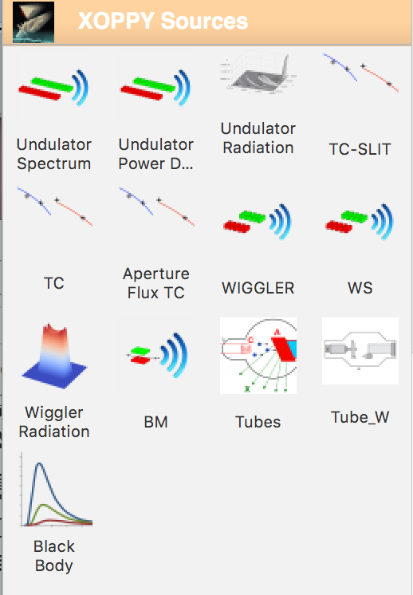
Source emission (XOPPY)
Undulator spectrum (flux or power versus E)
Undulator power density (power versus X,Y)
Undulator Spectrum (flux/power vs X,Y,E)
Undulator tuning curves
Wiggler spectrum Spectrum (flux/power vs X,Y,E)
BM Spectrum (flux/power vs E, angle)
Others

Slide 18
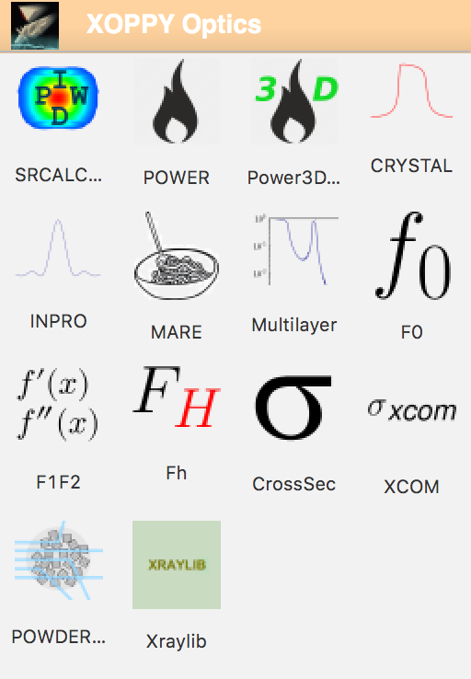
Optical elements (XOPPY)
Attenuators
Mirrors
Multilayers
Crystals

Slide 19
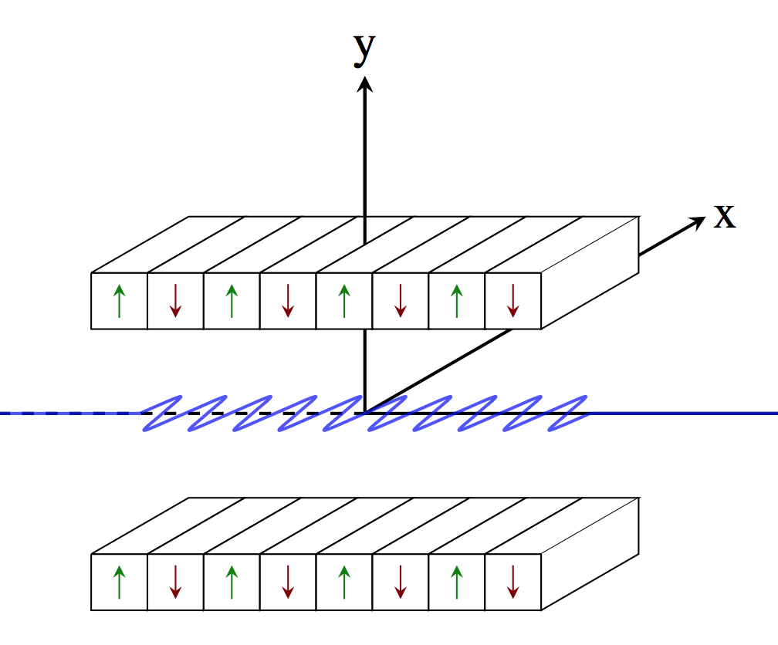
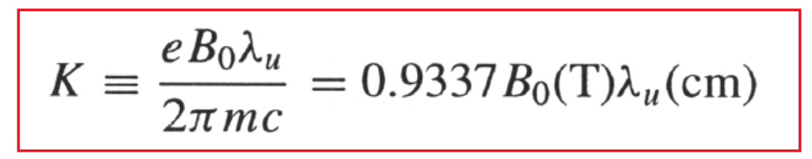
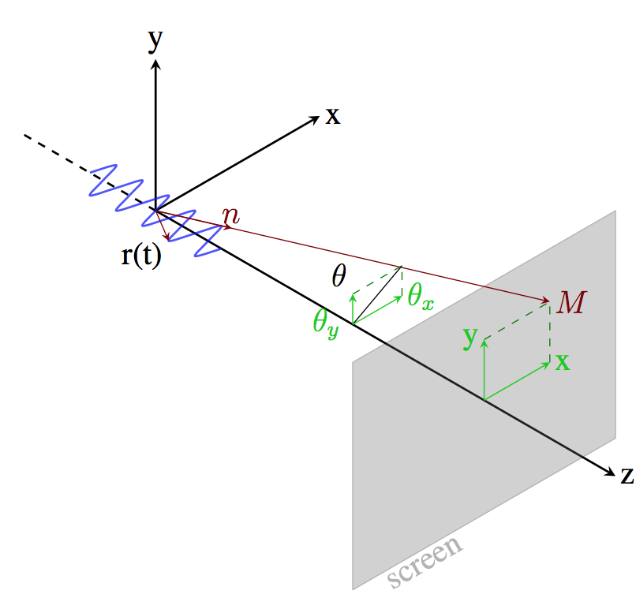
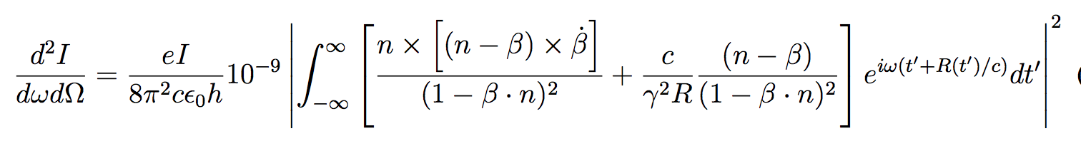
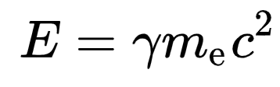
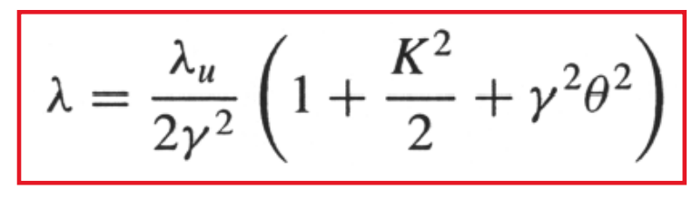
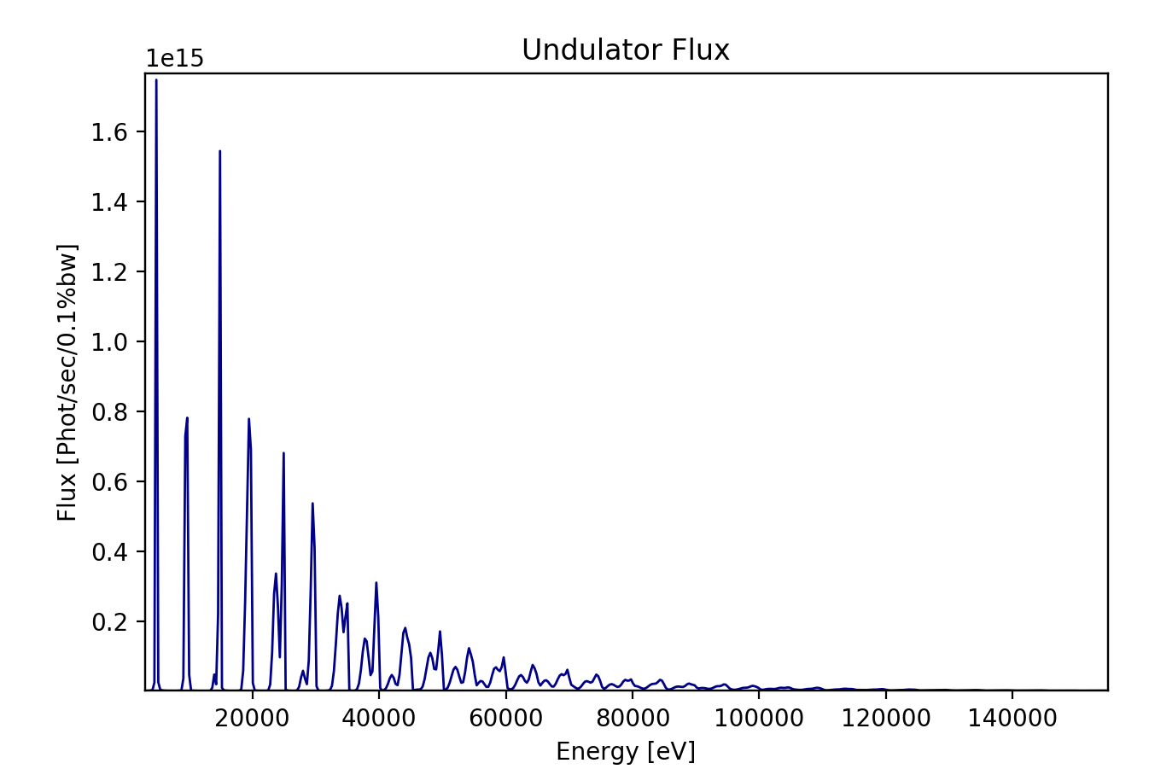
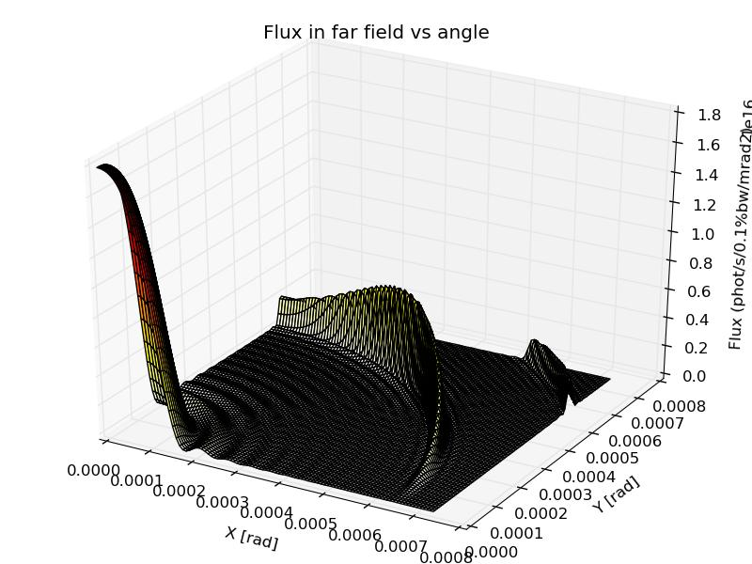
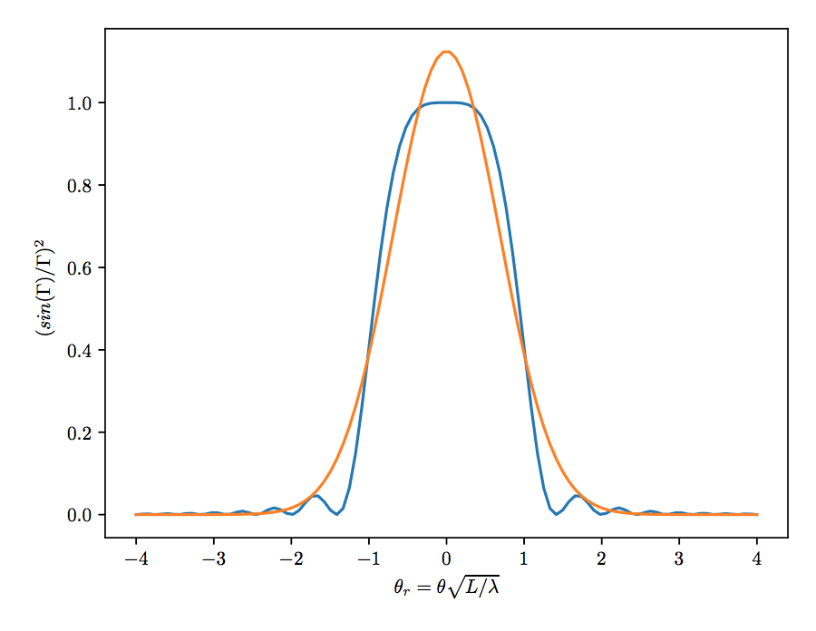
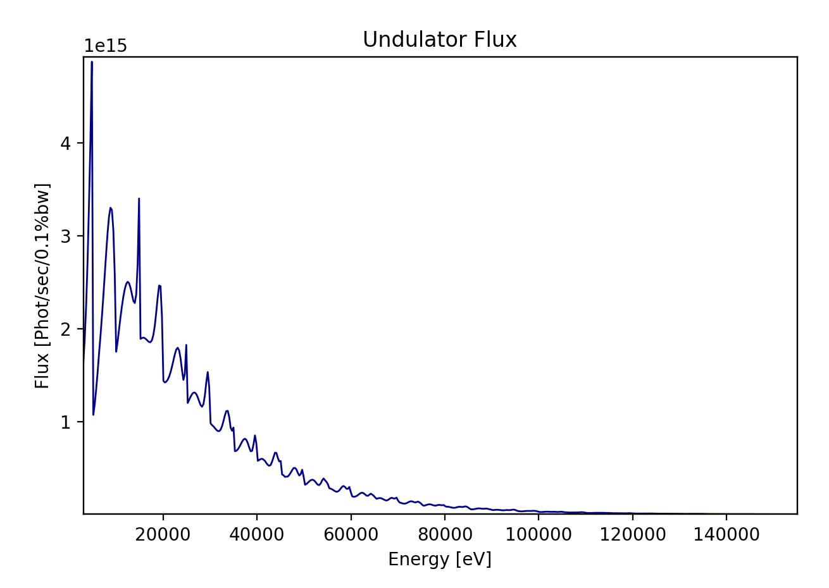
Undulator Memorandum
Undulator emission, after classical electrodynamics (e.g., Jackson, etc)
m_{e}c² = 0.51 MeV
On resonance approximation
Slit (2.1 x 1 mm²)
On resonance
Slit (10 x 10 mm²)
Onuki & Elleaume Undulators, Wigglers and their applications, CRC press, 2002
19

Slide 20
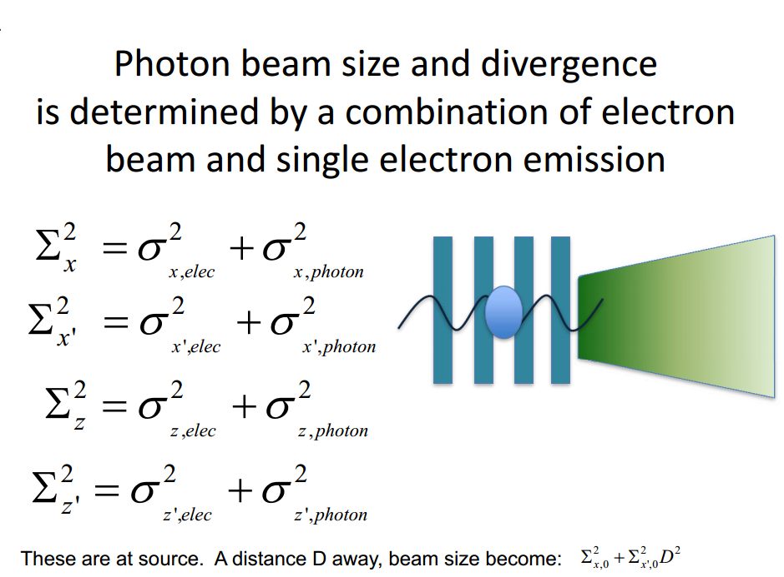
Courtesy: Boaz Nash
(FOR UNDULATORS, THESE FORMULAS ARE VALID AT THE WAIST, AT THE UNDULATOR RESONANCE, AND SUPOSSING GAUSSIAN EMISSION OF PHOTONS)
ShadowOui performs “numeric convolution” by Monte Carlo sampling of the electron beam [Gaussian] and photon emission [non Gaussian]

Slide 21
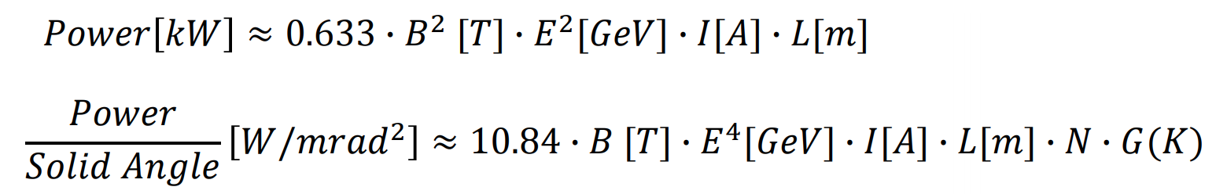
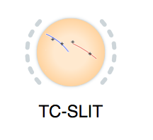
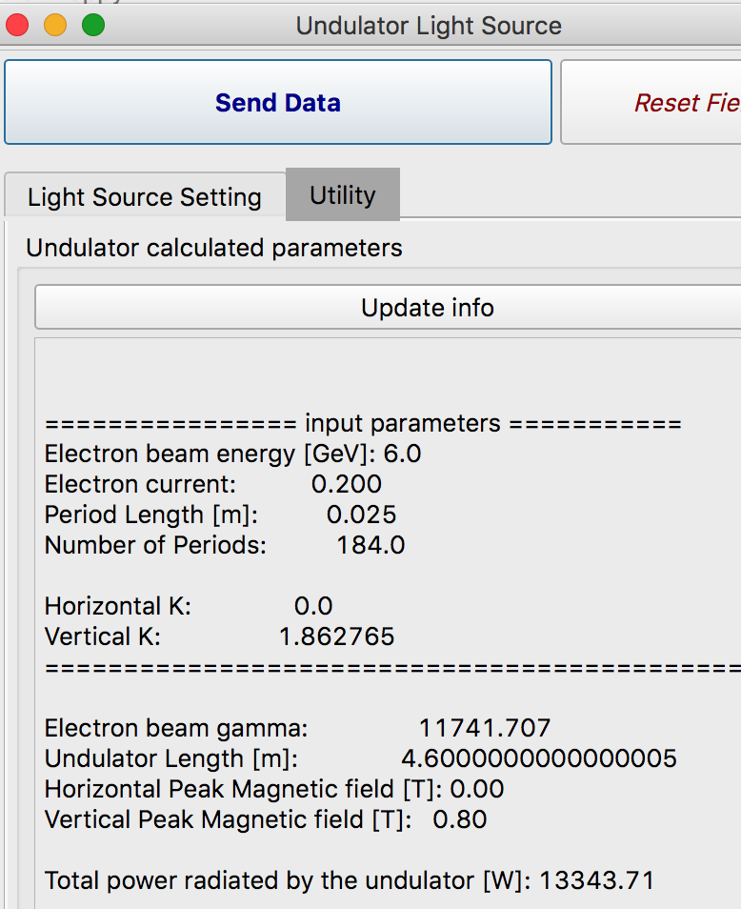
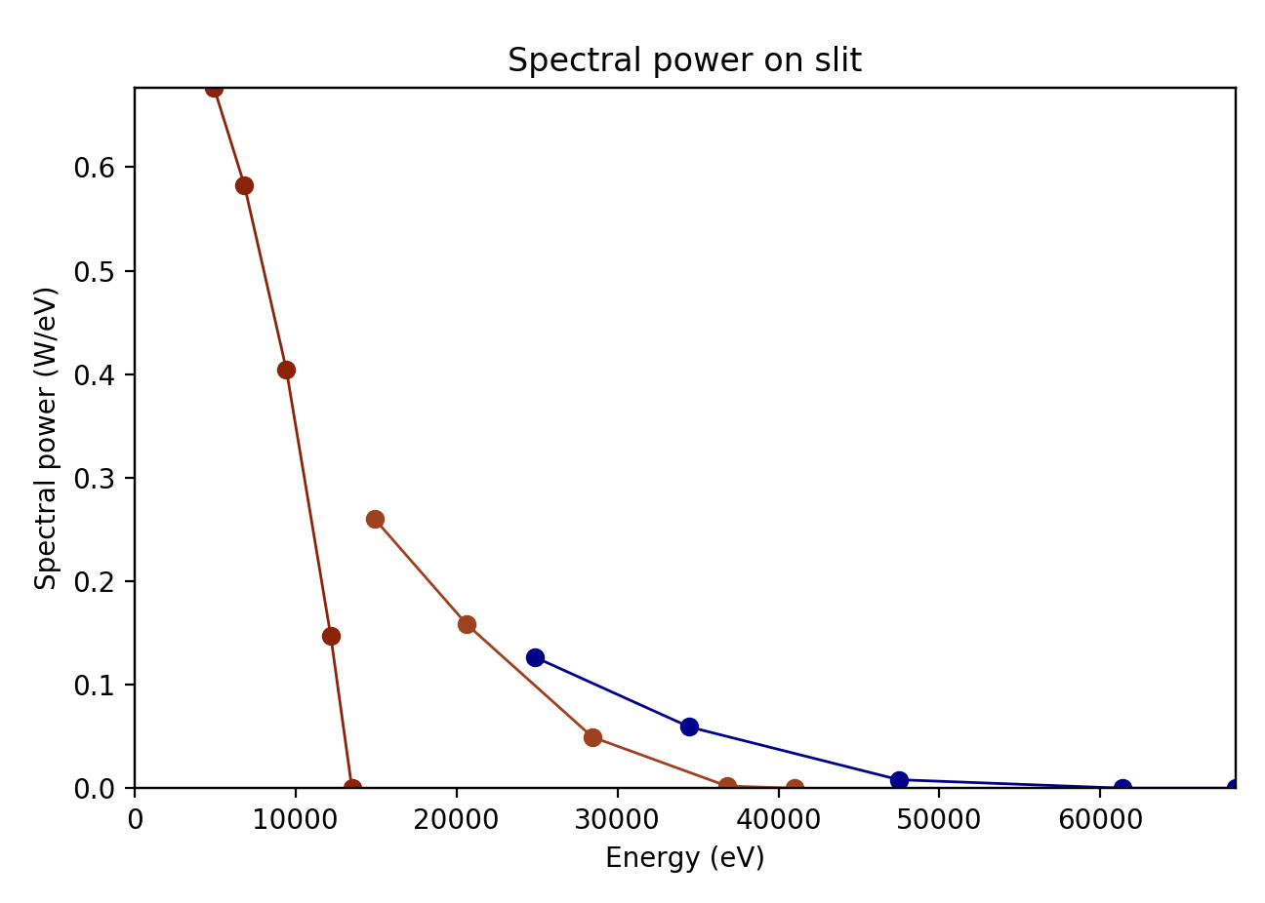
Undulators: Power and spectral calculations
Maximum power is obtained at highest K (or B) corresponding to the minimum photon energy
The spectral range covered by undulator is shown by the Tuning Curves.
21

Slide 22
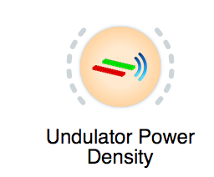
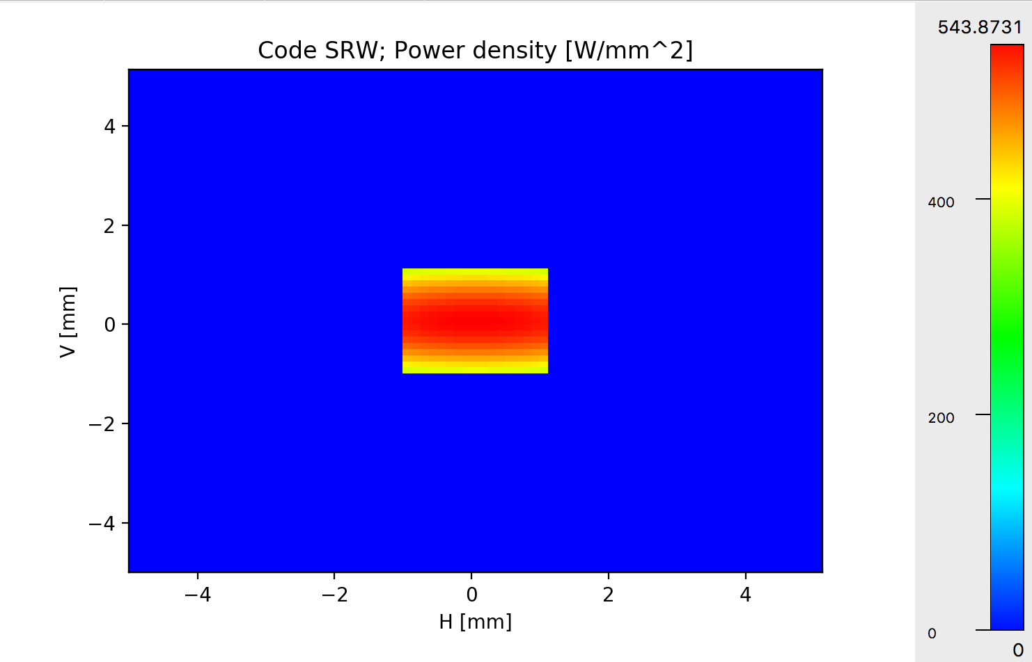
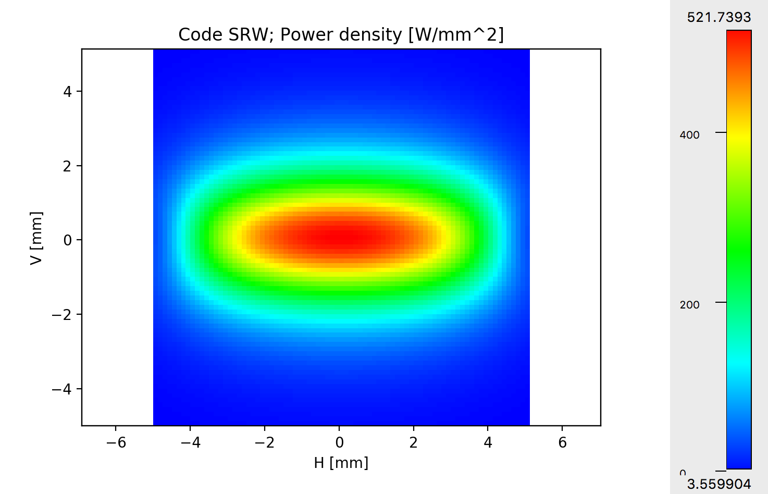
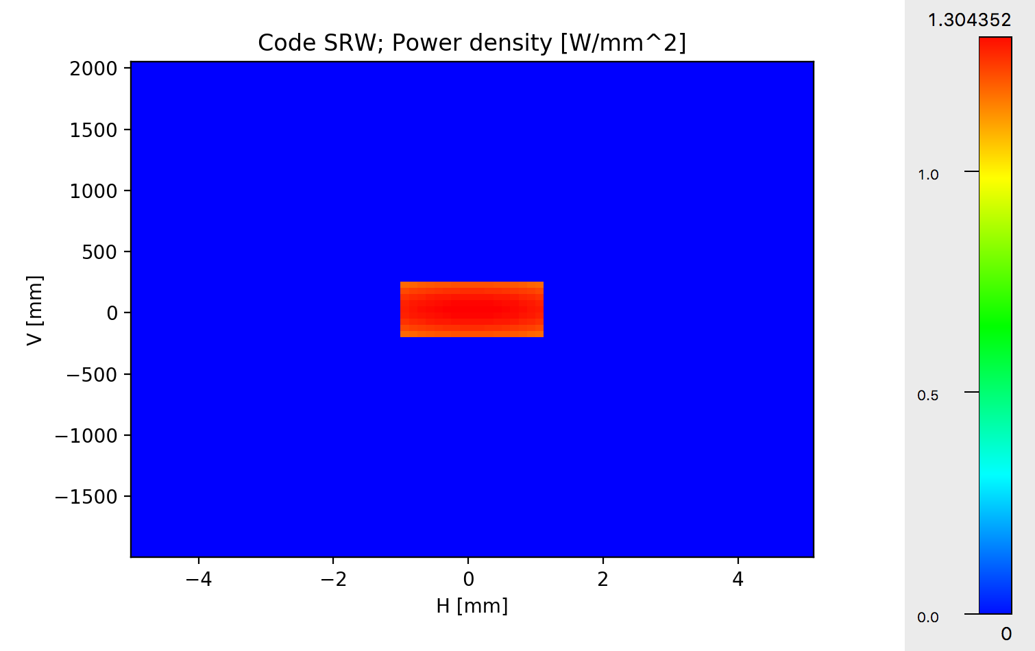
Power density (Power vs X and Y)
Mask
2x2 mm @ 25.4,=m
Or
2.1x2.1 @ 28m
6 sigma 1.32 mm
Mirror:
400mm
2.1mm (mask)
Tips:
Calculate on aperture large enough to accept all the radiation
Select “modify slit” to calculate power on smaller slit and to calculate power density on mirror surface
22

Slide 23
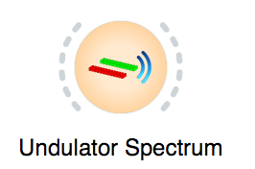
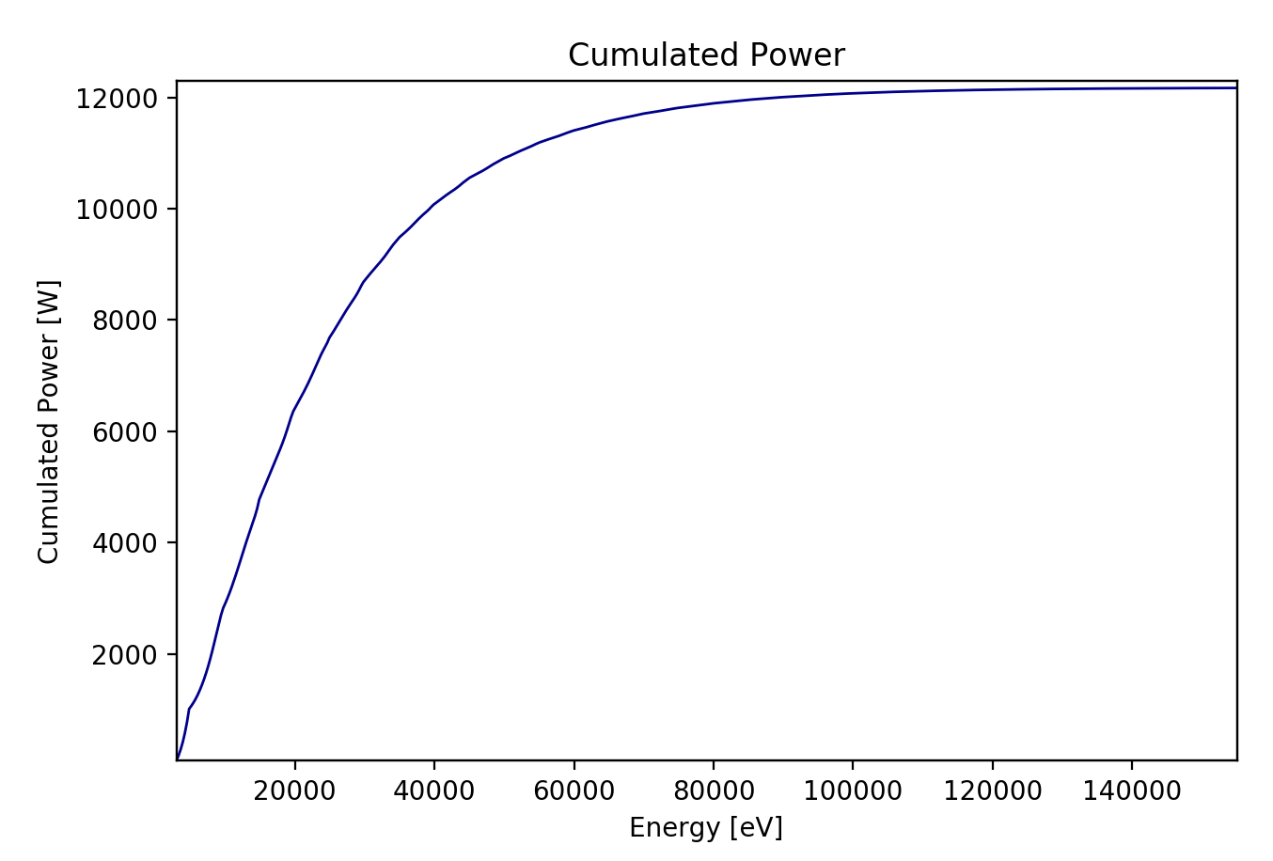
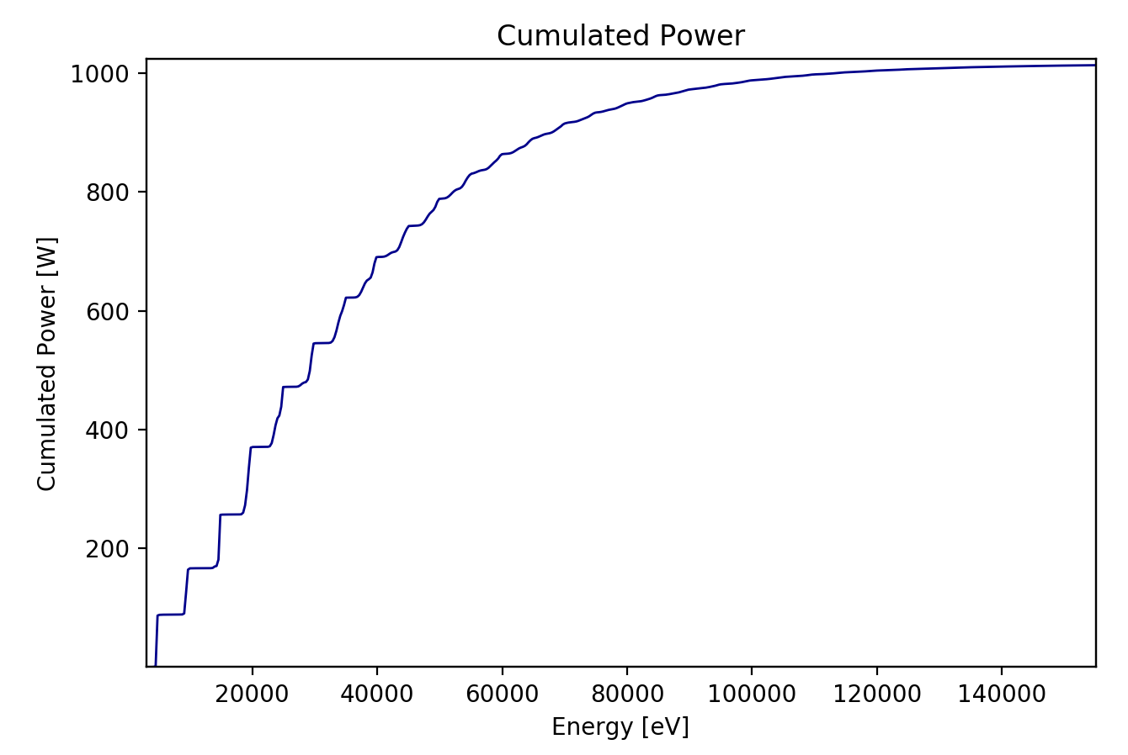
Flux and Spectral Power
Open Slit (10 x 10 mm²)
Slit (2.1 x 1 mm²)
23

Slide 24
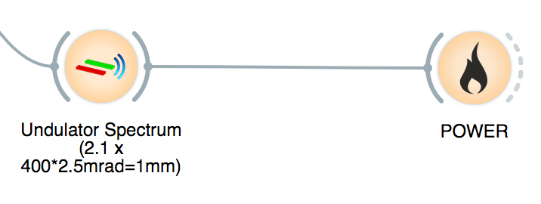
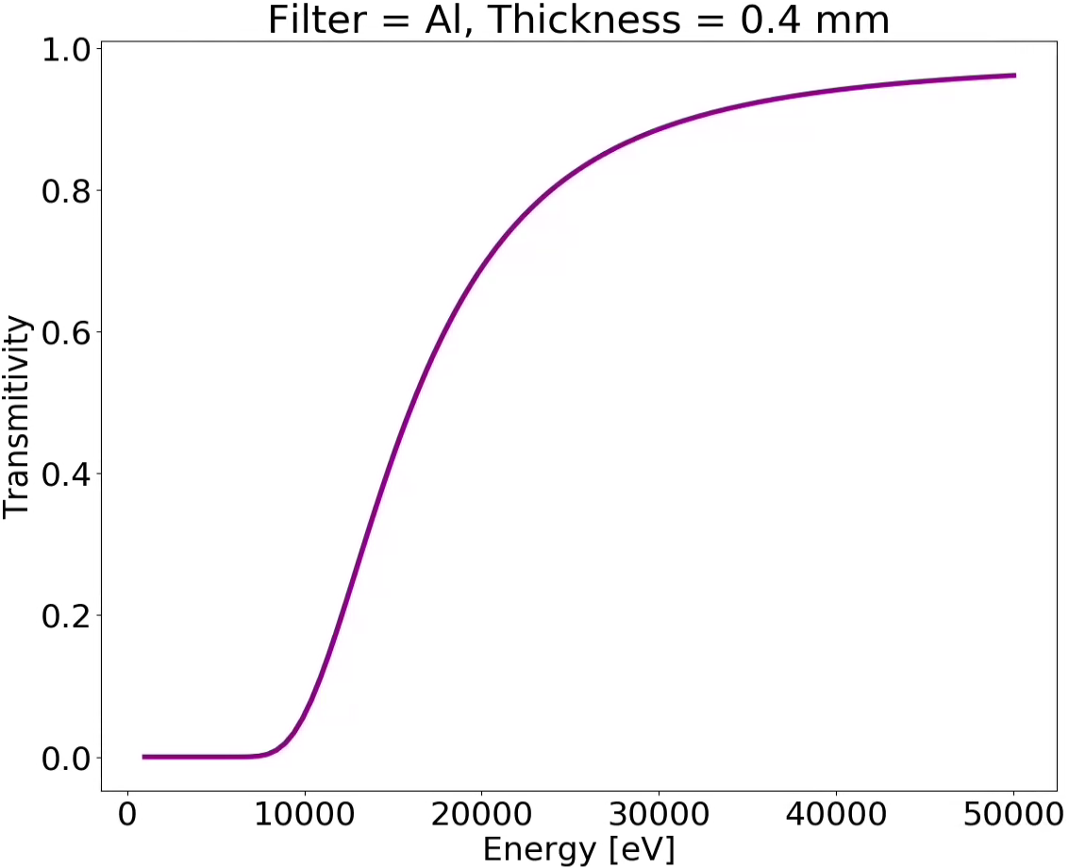
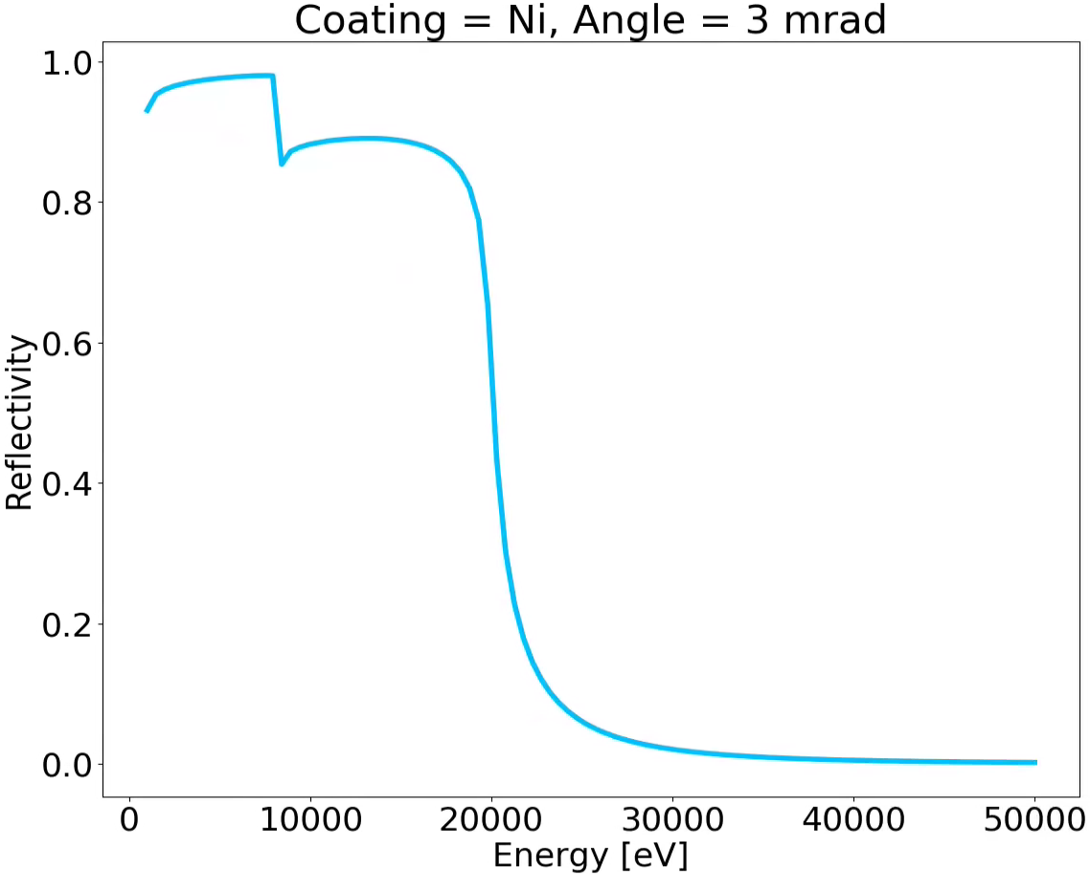
Spectral response of mirrors and attenuators (filters)
XOPPY
Interaction of radiation with matter
0.4 mm
X-ray beam
Al
X-ray beam
Mirror Angle
Ni coating
Second OASYS School – ANL APS - December 11-13, 2019
24

Slide 25
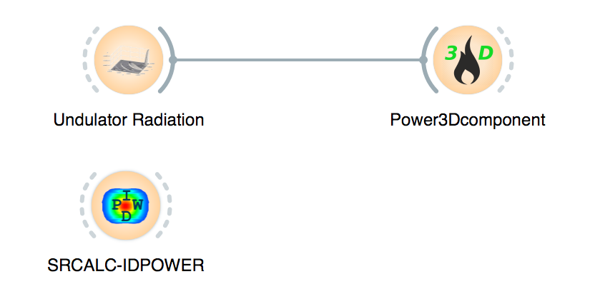
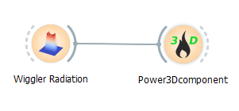
Combined (X,Y,E) effect of optical elements

Slide 26
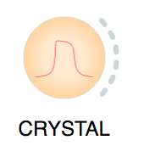
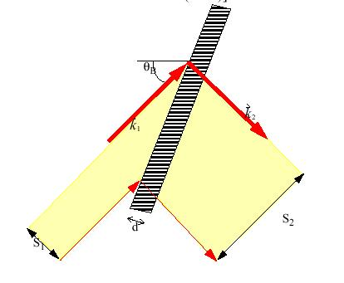
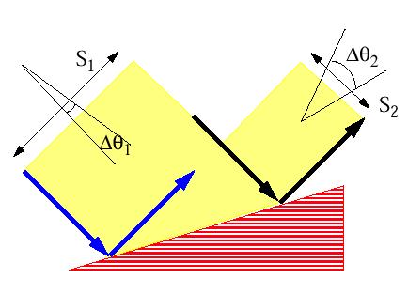
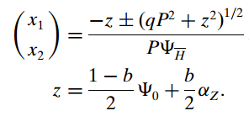
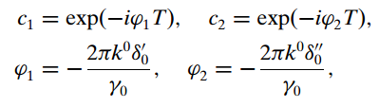
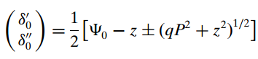
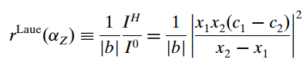




Crystals: Zachariasen treatment for plane crystals
BRAGG or reflection
LAUE or transmission
26

Slide 27









Crystals: Rocking curves
The rocking curve is the CONVOLUTION of the two diffraction profiles.
=
FWHM_{R} = 1.4 FWHM₁
=
FWHM_{R} = 1 FWHM₁
=
FWHM_{R} ~ 1.5 FWHM₁
_{Si111 8 keV}
For a full discussion about rocking curves see: Masiello et al. J. Appl. Crystall. 47, 1304-1314 (2014)
27

Slide 28


Mirror reflectivity F1F2
28

Slide 29


Multilayer reflectivity
29

Slide 30
Outline
Introduction to OASYS
XOPPY toolbox: Source emission and characteristics of optical elements. Power transport
ShadowOUI: Ray tracing SR beamlines
Mirror aberrations
Crystal systems
Lenses
WOFRY and SRW: coherent beam transport:
Simple examples with WOFRY
Introduction to Partial coherence

Slide 31





Trace (the beamline)
z
$${\vec{x}}_{0}=(x_{0},y_{0},0) \\ \vec{v}=(v_{x},v_{y}≈1,v_{z})$$
$${\vec{k}}_{o}={\vec{k}}_{i}−2\left({\vec{k}}_{i}⋅\vec{n}\right)\vec{n}$$
Energy, Intensity
y
x
z
z
p
q
x
$$\vec{x}={\vec{x}}_{0}+t\vec{v} \\ z=0$$
y
x

Slide 32
Continuation planes
Optical axis
Side View
Top View
Image Plane for O.E.1
Source Plane for O.E.2
Image Plane for O.E.2
Source Plane for O.E.1
O.E.1
O.E.2

Slide 33

Note that (VERY IMPORTANT!):
The y(2) coordinate is along the beam direction
The position (Source Plane Distance), orientation (O.E. Orientation Angle) of any o.e. is always referred to the previous one
Source Plane and Image Plane for each optical element are the “Continuation Planes”
The frame is rotated if one o.e. is rotated

Slide 34


SHADOW ray’s variables (columns)
Stored:
Computed:
*
**
* X’,Y’,Z’ is the direction vector (unitary), for small angles (always in SR) Y’<~1, and X’ and Z’ can be considered “divergences”
** Column 11 is energy in eV. Internally SHADOW stores the wavenumber 2 π / λ in cm⁻¹

Slide 35
Optical elements
For each optics element SHADOW includes:
Geometrical model: how the direction of the rays are changed (reflected, refracted or diffracted)
Physical model: how the ray intensity (in fact electric fields) decreases because of the interaction
Structures along the surface =>playing with the direction
Structures in depth => playing with the reflectivity

Slide 36





ShadowOUI Sources I

Slide 37







Sources II (Wiggler and also mutiple BMs and Short IDs)

Slide 38









Sources III (Undulator)
Fake Geometrical Source
(Gaussian spatial + Gaussian divergency)
Single e⁻
Photon source:
Divergence:
Size:
Full Undulator
789.938eV
806.060eV
814.121eV

Slide 39



Optical Elements (mirrors) Geometrical model Physical model
Fresnel equations give the reflectivity as a function of angle and photon energy. As a consequence, one gets the critical angle:
Si σ-reflectivity

Slide 40

Optical Elements (gratings)
Geometrical model Physical model
No model (yet) in SHADOW for grating efficiency
SHADOW uses Fresnel equations like for mirrors
Figure from doi.org/10.5772/51044

Slide 41


Optical Elements (crystals)
Geometrical model Physical model

Slide 42

Mirrors and aberrations
R
Ellipsoid: Point to point focusing
Paraboloid: Collimating
Focalization in two planes
Tangential or Meridional (ellipse or parabola)
Sagittal (circle)
Demagnification: M=p/q
Easier manufacturing:
2D: Ellipsoid => Toroid
Only one plane: cylinder Ellipsoid (ellipse)=> cylinder (circle)
Sagittal radius: non-linear (ellipsoid) => constant (cylinder) or linear (cone),
All mirrors produce aberrations
p
q
ρ

Slide 43





Crystal monochromators
ex17_crystalmono.ows
Theory of the Use of More Than Two Successive X-Ray Crystal Reflections to Obtain Increased Resolving Power J W. M. DuMond Phys. Rev. 52, 872 – (1937) http://dx.doi.org/10.1103/PhysRev.52.872

Slide 44


Crystal curvature and spectral resolution
Zero for Rowland mounting:
p = R sin(θ) that for Bragg
symmetric reflection means
1:1 magnification

Slide 45



X-ray Lenses
p
q

Slide 46







CRL (COMPOUND REFRACTIVE LENSES) = replicate N lenses
Compound Refractive Lens (CRL)
Single interface
Lens
Transfocator
1996 Experimental demonstration of CRL
A. Snigirev et al Nature 384 (1996) 49
2011 Transfocator

Slide 47
Outline
Introduction to OASYS
XOPPY toolbox: Source emission and characteristics of optical elements. Power transport
ShadowOUI: Ray tracing SR beamlines
Mirror aberrations
Crystal systems
Lenses
WOFRY and SRW: coherent beam transport:
Simple examples with WOFRY
Introduction to Partial coherence

Slide 48
Wave optics
Based on sampling a wavefront (monochromatoc and coherent), and propagate it (in free space and trough optical elements)
2D wavefront sampling is costly ~N^2
Propagation is expensive N^4 or N^2 if FFT
Optical elements modelled as thin objects
Parameter setting is complex

Slide 49

Wavefront and Propagator discretization
Effect of the discretization: Replicas
Replicas can be avoided by increasing the sampling or by isolating the main feature at the image plane, if the replica are well separated.
Effect of under-sampling: Aliasing
Under-sampling produces an overlapping of the replicas, thus completely distorting the expected result. This effect is called aliasing.

Slide 50

SRW (Oleg Chubar, BNL)
https://github.com/ochubar/SRW
Chubar, O. and Ellaume, P.: Accurate and efficient computation of synchrotron radiation in the near field region. Proceedings of the 6th European Particle Accelerator Conference - EPAC-98, pages 1177-1179
Chubar, O.: Wavefront calculations. Proc. SPIE, 4143:48-59 (2001)
Chubar, O., Berman, L., Chu, Y. S., Fluerasu, A., Hubert, S., Idir, M., Kaznatcheev, K., Shapiro, D. Shen, Q. and Baltser, J.: Development of partially-coherent wavefront propagation simulation methods for 3rd and 4th generation synchrotron radiation sources. Proc. SPIE, 8141:814107 (2011)
Chubar, O.: Recent updates in the "Synchrotron Radiation Workshop" code, on-going developments, simulation activities, and plans for the future. Proc. SPIE, 9209:920907 (2014)
Chubar, O., Rakitin, M., Chen-Wiegart, Y.K., Chu, Y.S., Fluerasu, A., Hidas, D. and Wiegart, L.: Main functions, recent updates, and applications of Synchrotron Radiation Workshop code. Proc. SPIE, 10388:1038805 (2017)
OASYS interface by Luca Rebuffi
Chubar, O. and Celestre, R.: Memory and CPU efficient computation of the Fresnel free-space propagator in Fourier optics simulation. Opt. Express 27, 28750-28759 (2019)

Slide 51

WOFRY (OASYS team)
Simpler use
Basic wavefronts (plane waves, spherical waves)
1D and 2D modes (less expensive)
Approximated undulator sources
Effective propagators
Not as complete as SRW but growing fast
Good for prototyping beamlines

Slide 52


Propagators
Fresnel
Fresnel (convolution)
Integral
Fresnel Zoom
Fresnel Zoom Scaled
1D
2D

Slide 53


Zoom Propagator
G. Pirro, Master Thesis (2017)
https://github.com/oasys-kit/documents/blob/master/zoom_propagator_pirro_thesis.pdf

Slide 54




wofry_examples.ows simple propagation cases
Aperture=0.4 mm, Ε=17225 eV, D=5cm
Converging spherical +
Propagation (D)
Plane + Lens (F=D)+ Propagation (D)
F=D
Spherical divergent+ Lens (F=D/2)+ Propagation (D)
F=D/2
Gaussian+ Propagation(D)+ Lens (F=D/2)+ Propagation (D)
F=D/2
54

Slide 55


2D Oversimplified Beamline
Theoretical consideration
The diffraction by a DxD square aperture of a collapsing spherical wavefront has an intensity distribution proportional to sinc²(kDx/2f ) sinc²(kDy/2f), where k=2π/λ, x(y) is the horizontal (vertical) coordinate, and f is the distance aperture-focus (D/f is the divergence). Considering that the FWHM of sinc²(x) is approximately 2.78, one obtains a FWHM=0.885 * wavelength / divergence=18nm

Slide 56
Partial coherence

Slide 57








Partial coherence is due to the electron beam emittance
Multielectron Calculation (SRW)
W ~ 10⁸ – 10¹² (Gb-Tb)
Propagate: 4D integrals
Coherent mode decomposition
http://dx.doi.org/10.1209/0295-5075/119/34004 Mark Glass, Manuel Sanchez del Rio (2017) Coherent modes of X-ray beams emitted by undulators in new storage rings EPL (Europhysics Letters) 119
4D function
2D functions
Store m x N x N Propagate: 2D integrals

Slide 58

COMSYL EBS SOURCE (CF 0.028)
https://youtu.be/h24RrJZaQ80

Slide 59

COMSYL HIGH BETA SOURCE (CF 0.0013)
https://youtu.be/GqJkfv186x0

Slide 60
Example approximating the Undulator by the Gaussian Shell-model

Slide 61




SIMPLE CASE: 1D Gaussian SHELL-MODEL
Both intensity (Spectral Density) and correlation (Spectral Degree of Coherence) are Gaussians
σ_{I}>>σ_{μ} the source is mostly incoherent (quasi homogeneous)
σ_{I}<<σ_{μ} is mostly coherent
I
I
Eigenvalues
Eigenfunctions
(Hermite-Gaussian modes)
Magic property: Propagation invariance
In the first mode (Gaussian) :
In 2D (H x V)
2D Hermite-Gaussian or
TEM_{nm} modes

Slide 62






The spectrum of coherent modes
Eigenvalues
Mode occupation:
Coherent: β>>
Coherent fraction:
incoherent
β<<
In general we cannot apply Gaussian Shell-model to synchrotron

Slide 63
More slides

Slide 64







ELECTRON BEAM DESCRIPTION
In storage rings, the electrons are statistically distributed inside bunches
P₁
P₂
P₃
General
No z-coupling
Finite alpha
Symmetry point

Slide 65


Stotage ring: electron beam sizes
Horizontal emittance = 147 pm
With ε the emittance (constant), and Twiss parameters:
At s (any point of the trajectory):
EBS (S28D):
β_{x} = 6.90 m
β_{y} = 2.64 m
σ_{x} = 30.2 μm
σ_{y} = 3.64 μm
σ_{x’}= 4.37 μrad
σ_{z’}=1.37 μrad
At waist (zero correlation, ρ=α=0, β is minimum):

Slide 66
SINGLE ELECTRON PHOTON EMISSION (Zero emittance)
Undulator emission, after classical electrodynamics (e.g., Jackson, etc)

Slide 67


Undulator emission (single electron or filament beam or zero emmittance) (after Onuki & Elleaume, Undulators, Wigglers and their applications, CRC press, 2002)
Undulator beams have not Gaussian profiles (even at resonances)
These formulas are APPROXIMATED!

Slide 68
m_{e}c² = 0.51 MeV

Slide 69
Courtesy: Boaz Nash
(FOR UNDULATORS, THESE FORMULAS ARE VALID AT THE WAIST, AT THE UNDULATOR RESONANCE, AND SUPOSSING GAUSSIAN EMISSION OF PHOTONS)
ShadowOui performs “numeric convolution” by Monte Carlo sampling of the electron beam [Gaussian] and photon emission [non Gaussian]

Slide 70
Mirror shape
Ellipsoid: Point to point focusing
Paraboloid: Collimating
Focalization in two planes
Tangential or Meridional (ellipse or parabola)
Sagittal (circle)
Demagnification: M=p/q
Easier manufacturing:
2D: Ellipsoid => Toroid
Only one plane: cylinder Ellipsoid (ellipse)=> cylinder (circle)
Sagittal radius: non-linear (ellipsoid) => constant (cylinder) or linear (cone),
All mirrors produce aberrations
R
p
q
ρ

Slide 71

Mirrors Geometrical model Physical model Specular reflection Fresnel formulas
Fresnel equations give the reflectivity as a function of angle and photon energy. As a consequence, one gets the critical angle:
Si

Slide 72
LENS
p
q

Slide 73
CRL (COMPOUND REFRACTIVE LENSES) = replicate N lenses
Compound Refractive Lens (CRL)
Single interface
Lens
Transfocator
1996 Experimental demonstration of CRL
A. Snigirev et al Nature 384 (1996) 49
2011 Transfocator

Slide 74


HIGH DEMAGNIFICATION with SINGLE LENSES
material->air air->material
K. Evans-Lutterodt et al
Single Element elliptical hard X-ray micro-optics
Opt. Expr. 11, 8, 919-926 (2003).
M. Sánchez del Rio & L. Alianelli,
J. Synchr. Rad. 19 (2012) 366
When illuminating with coherent light, reducing acceptance decreases N.A. therefore increases coherent diffraction ~0.61 λ/ (h/q)
The rays become very grazing to there is total reflection. Not a limitation for kinoform lenses (K. Evans-Lutterodt et al Phys. Rev. Lett. 99 (2007)). For standard lenses one can reverse the lens.
There is a lot of absorption => remove material and convert it to a Fresnel lens (W. Jark et al J. Synchr. Rad. 13 (2006))
Use the lens shape adapted for your needs

Slide 75





DARWIN TREATMENT OF DYNAMICAL THEORY (1914) – the darwin width

Slide 76
The Zachariasen treatment for plane Crystals
BRAGG or reflection
LAUE or transmission

Slide 77
ROCKING CURVES
The rocking curve is the CONVOLUTION of the two diffraction profiles.
=
FWHM_{R} = 1.4 FWHM₁
=
FWHM_{R} = 1 FWHM₁
=
FWHM_{R} ~ 1.5 FWHM₁
_{Si111 8 keV}
For a full discussion about rocking curves see: Masiello et al. J. Appl. Crystall. 47, 1304-1314 (2014)

Slide 78


ON THE DIRECTION OF THE OUTCOMING WAVE
A crystal behaves like a grating or prism, except the Bragg Symmetric crystal that behaves like a mirror.
When combined with reflectivities from dynamical theory we can do ray tracing (beam decomposed in plane waves)

Slide 79
Theory of the Use of More Than Two Successive X-Ray Crystal Reflections to Obtain Increased Resolving Power J W. M. DuMond Phys. Rev. 52, 872 – (1937) http://dx.doi.org/10.1103/PhysRev.52.872
ex17_crystalmono.ows

Slide 80
Energy Resolution

Slide 81






EFFECT OF CRYSTAL ANISOTROPY in bent crystals
111
11-2 or 1-10
M. Sanchez del Rio, N. Perez-Bocanegra, X. Shi & V. Honkimaki, J. Appl. Cryst. (2015). 48, 477-491

Slide 82





Multiple BRAGG Diffraction
Simultaneous multiple diffraction occurs when the incident wave finds several sets of planes satisfying the Bragg law.
They were first discovered by Renninger (1937) so they are called Renninger reflections of detour reflections (umweganregung).
Kinematical theory (Cole, Acta Cryst.15 138 (1962); Rossmanith PSILAM; XOP/MARE)
Beyond kinematical theory (Colella, Acta Cryst. A30, 413 (1974); Shen; Stepanov http://x-server.gmca.aps.anl.gov)

Slide 83








HYBRID METHOD IN SHADOW (X. Shi et al.) Combining ray tracing and wavefront propagation
Ideal lens with focal lengths of f_{x} and f_{z}
Ray tracing of the beamline

Slide 84





COHERENT LENGTHS - TWO WAVES http://www.csrri.iit.edu/~segre/phys570/10F/lecture_04.pdf
Starting with TWO well defined (thus coherent) waves with THE SAME intensity:
LONGITUDINAL (TEMPORAL) COHERENCE LENGTH L_{L}
Distance over which two waves from the same source point with slightly different wavelengths will completely dephase.
TRANSVERSE COHERENCE LENGTH L_{T}
The lateral distance along a wavefront over which there is a complete dephasing between two waves of the same wavelength, which originate from two separate points in space

Slide 85
correlation lengths for a typical synchrotron
the synchrotron beam is not formed by two single monochromatic plane waves
But we give some approximated values…
LONGITUDINAL COHERENCE
Imagine that a typical monochromator:
Produces a typical of ∆λ/λ = 10⁻⁴ (Si 111) peak distribution (Gaussian)
For main wavelength of λ = 1Å we select two lines thus separated its width ∆λ = 10⁻⁴ Å
The wavefronts of these two monochromatic waves are plane and identical
STATIONARY: This correlation time is much smaller than “bunch time” ~ 15 10⁻³ / c ~10⁻¹² s~ ps

Slide 86





FRAUNHOFER DIFFRACTION
z1 z2
Fourier transform with conjugated variables:
x ; f_{x}=x/(λ z) ~ sinθ/λ (same for y)
The same shape for different distances
f_{x}=x/(λ z) ~ sinθ/λ ~ θ/λ
F1 = np.fft.fft2(image) # Take the fourier transform of the image

Slide 87






FRESNEL DIFFRACTION
Numeric calculation: convolution with a Gaussian kernel
CONVOLUTION

Slide 88

Quantifying efficiency of the source to emit coherent radiation:
coherent fraction for SR lattices (Undulator emission)

